Slide 1

Obesity Paradox in Repast
Antinori Alessandro
Carletti Tommaso
Coltrinari Riccardo
Scarpetta Marco
Distributed Calculus and Coordination
A.Y. 2020-2021

Slide 2
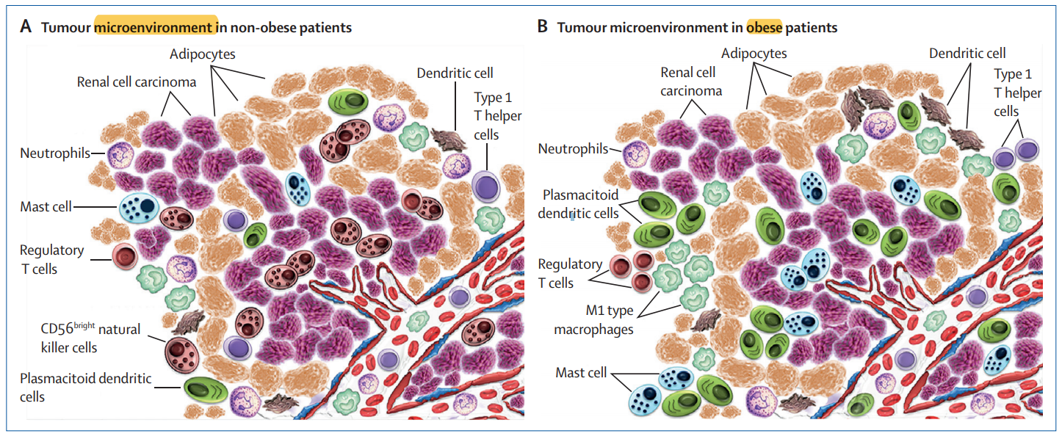
The Obesity Paradox
Obesity is associated with an increased risk of developing clear cell renal cell carcinoma (ccRCC) but, paradoxically, obesity is also associated with improved oncological outcomes in this cancer.
Figure 1. Perinephric tumour microenvironment in non-obese vs obese patients with renal cell carcinoma. [1]

Slide 3
Goals
Use the agent-based approach with Repast
Model Renal Cell Carcinoma microenvironment
Model cells behaviours and their interactions
Perform batch runs and analyse the results

Slide 4
Why Repast?
First Game of Life implementation in Netlogo (user-friendly platform but not so useful as complexity increases)
Repast Symphony:
Well documented
More flexibility
Access to the whole range of Java libraries

Slide 5
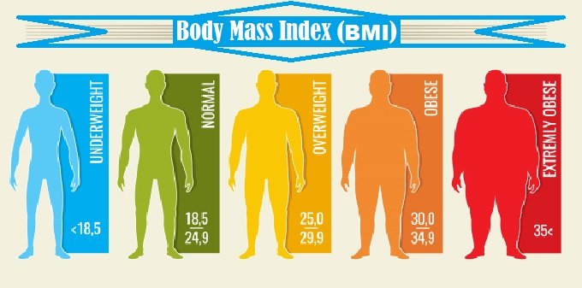
Environment - Body Mass Index (BMI)
Ratio between weight and square of the height of an individual and is used as an indicator of the state of ideal weight.
Main factor that affects the number and proportion of initial immune cells:
More Natural Killer in lean individuals
More Dendritic, Mast Cell and M1 Macrophage in obese individuals
Higher CD4/CD8 ratio in obese individuals
Figure 2. Body Mass Index representation.

Slide 6
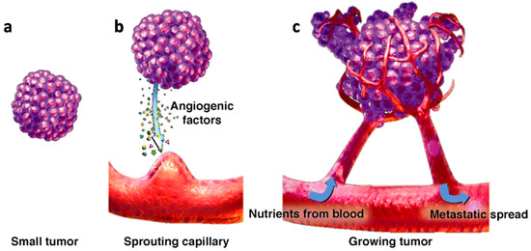
Environment - Blood Vessel
Component of the circulatory system that transports blood cells, nutrients, and oxygen to the tissues of the body.
The blood vessel can be the target of tumour angiogenesis, in which case tumour grows in an uncontrolled way.
Figure 3. (a–c) Tumor expansion induced by the sprouting of blood vessels. From small tumor (a), sprouting capillary (b) to growing tumor (c). [2]

Slide 7
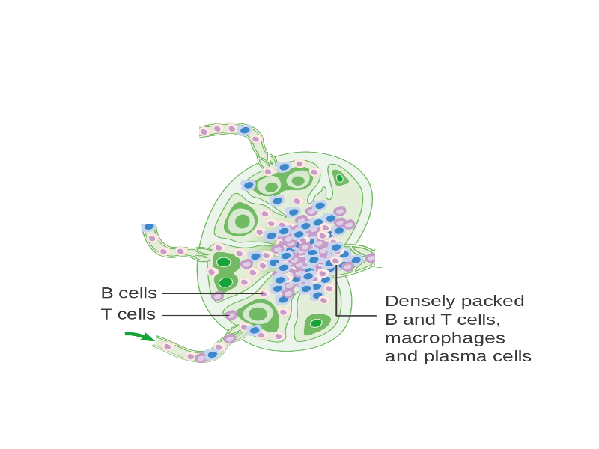
Environment - Lymph Node
Organ of the lymphatic adaptive immune system and major sites of lymphocytes that include B and T cells.
Lymph nodes are important for the proper functioning of the immune system, acting as filters for foreign particles including cancer cells, but has no detoxification function.
Once a Dendritic cell has reached the Lymph Node, carrying the antigen with it, if there is a T cell with the appropriate T cell receptor, it will be activated.
Figure 4. Lymph node representation. [9]

Slide 8
Agents
Agents are all those cells that are useful in our context and are divided in:
Immune
Not Immune
There are also other cells which have been useful in modeling the behavior of the immune system and which we will discuss briefly.

Slide 9
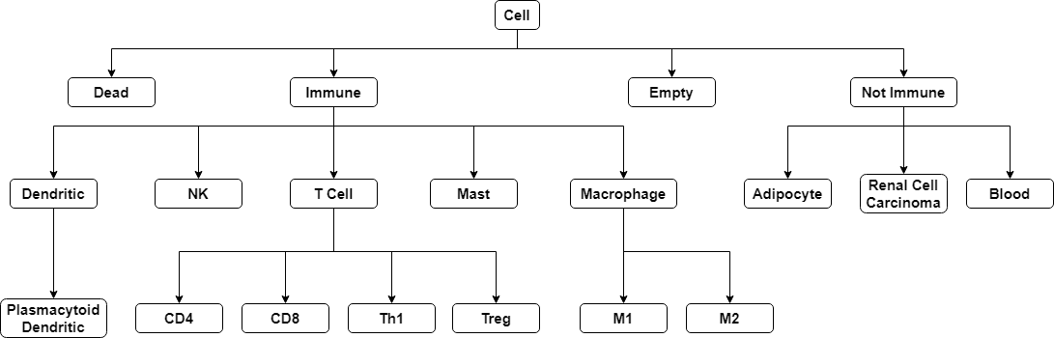
Agents Structure

Slide 10
Agent - Cell
Implementation:
Cell class is the root of all the hierarchical structure of classes.
Main features:
lifespan
current age and the fact that it can die
attribute self to check if it is foreign or not
It could be either a Immune Cell or a Not Immune Cell.

Slide 11
Agent - Immune Cell
Overview:
Agent that represent all the cells that are part of the immune system.
Implementation:
Main features:
attribute active to check if its effect can be activated
random movement to a nearby empty cell by default
can proliferate if a given percentage of the lifespan has been reached
when it is not active, by default, it looks for a nearby tumor and eventually becomes active (actIfNotActive method)
when active, each cell has to override the actIfActive method

Slide 12
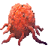
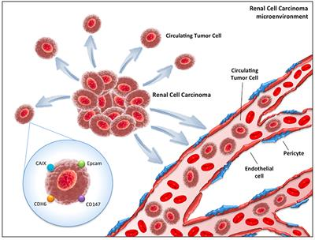
Agent - Renal Cell Carcinoma
Overview:
Tumor: mass of tissue that grows in excess and uncoordinated w.r.t. normal tissues.
Tumor cells are cells whose DNA has been modified, resulting in a change of the cell’s behavior.
They need a dedicated blood supply to provide the oxygen and other essential nutrients in order to grow ( Angiogenesis ).
A tumor cell can also implement strategies for not being recognized by the immune system’s cells (hiding MHC class I molecules). In this way, cells of the immune system treat a tumor cell as a self one and no action is performed against it.
Figure 5. Circulating tumor cells (CTCs) in renal cell carcinoma microenvironment. [3]

Slide 13
Agent - Renal Cell Carcinoma
Implementation:
Reproduction: grow method check if the time to expand has arrived (reproTime) or if there is a Mast Cell that is pro-tumor in its neighborhood: if one of these conditions is satisfied, the method reproduce is invoked to create new tumor cells, depending on reproFactor variable
Hiding MHC: when a tumour grows it can mutate and with a certain probability it changes the self variable to true
TCell inhibition: done by setting the TCells active variable to false, with a certain probability

Slide 14
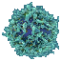
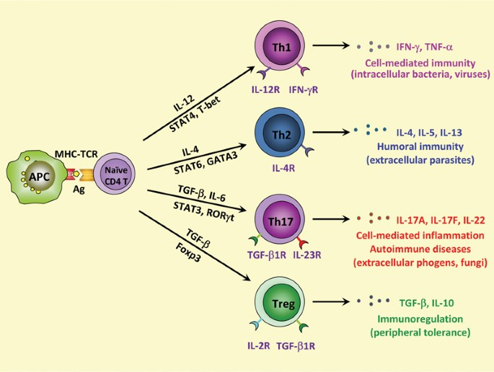
Agent - CD4+ Naïve T Cell
Overview:
Helper T Cells (also called CD4+ T Cells) help other cells of the immune system by releasing cytokines, small protein mediators that alter the behavior of target cells that expose receptors for those cytokines.
Upon activation they are able to differentiate themselves (via autocrine signaling) into either Th1, Th2, Regulatory T cells and other kinds of cells.
Figure 6. Differentiation of a CD4+ Naïve T Cell.

Slide 15
Agent - CD4+ Naïve T Cell
Implementation:
This kind of cell can be activated from any APC, such as Dendritic Cells, Macrophages, B cells and so on. Upon activation this cell can only differentiate either into Th1 or Treg.
It has a 10% probability to differentiate into Treg, otherwise it becomes a Th1.

Slide 16
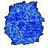
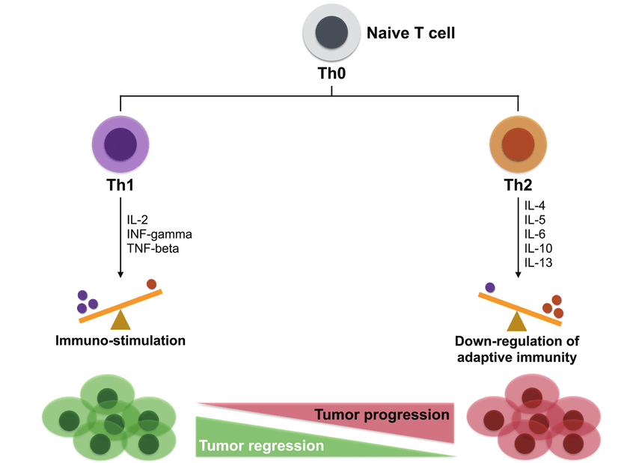
Agent - CD4+ Helper 1 T Cell
Overview:
Th1 cells mostly produce IFN-γ, interleukin (IL)-2, and TNF-β. [6]
These cytokines are able to activate and maximize the killing efficacy of the macrophages and the proliferation of CD8+ T Cells.
This kind of Helper T Cells also enhance the production of opsonizing, and some kind of antibodies involved in antibody-dependent cell cytotoxicity.
Figure 7.Th1/Th2 role in tumor microenvironment. [Lin et al. (2017)]

Slide 17
Agent - CD4+ Helper 1 T Cell
Implementation:
The release of IFN-γ and TNF-β has been simulated (implemented) defining 2 methods:
releaseIFNGamma: simulates the release of IFN-γ by activating all the macrophages that live within a certain radius of distance from the actual Th1
releaseTNFBeta: simulates the release of TNF-β by activating all the CD8+ T cells that live within a certain radius of distance from the actual Th1
After the release of the cytokines this cell is deactivated and moves randomly like any other immune cell.

Slide 18
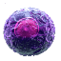
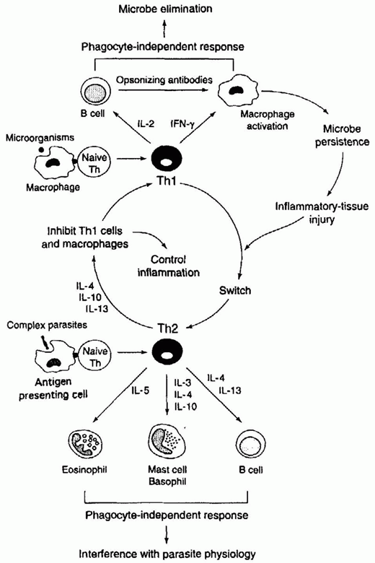
Agent - CD4+ Helper 2 T Cell
Overview:
Th2 cells are responsible in helping the humoral immune response enhancing mast cell differentiation, B Cells activation and eosinophil growth and differentiation factors.
They also play an important down-regulatory role by inhibiting Th1 cells and macrophages.
Implementation:
We have not provided an implementation for this cells because their role is mostly useful when there is an infection by parasites, while Th1 cells are most important in our case because they have a role in intracellular immune response. [6]
Figure 8. Th1/Th2 interactions [6]

Slide 19
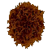
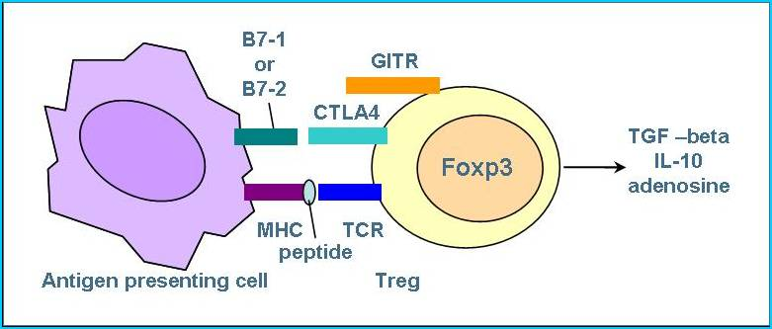
Agent - CD4+ Regulatory T Cell
Overview:
When active, Tregs suppress activation, proliferation and cytokine production of CD4+ T cells, CD8+ T cells and other immune cells.
They do this by secreting TGF-β that suppress proliferation and differentiation, and similarly IL-10 that is able to suppress cytokine synthesis of IFN-γ, TNF-α and other cytokines, produced by cells like macrophages and some kind of T helper cell.
Figure 9. Activation of a Regulatory T Cell. [5]

Slide 20
Agent - CD4+ Regulatory T Cell
Implementation:
The suppressive role of Regulatory T Cells has been simulated (implemented) defining 2 methods:
releaseTGFbeta: deactivates and decreases the growth factor of every T Cell that live within a certain radius of distance from the actual Treg Cell. In the same way it also deactivates M2 cells
releaseIL10: deactivates every M1, M2, Th1, Dendritic and Plasmacytoid Dendritic Cell that live within a certain radius of distance from the actual Treg Cell
After the release of the cytokines this cell is deactivated and moves randomly like any other immune cell.

Slide 21
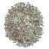
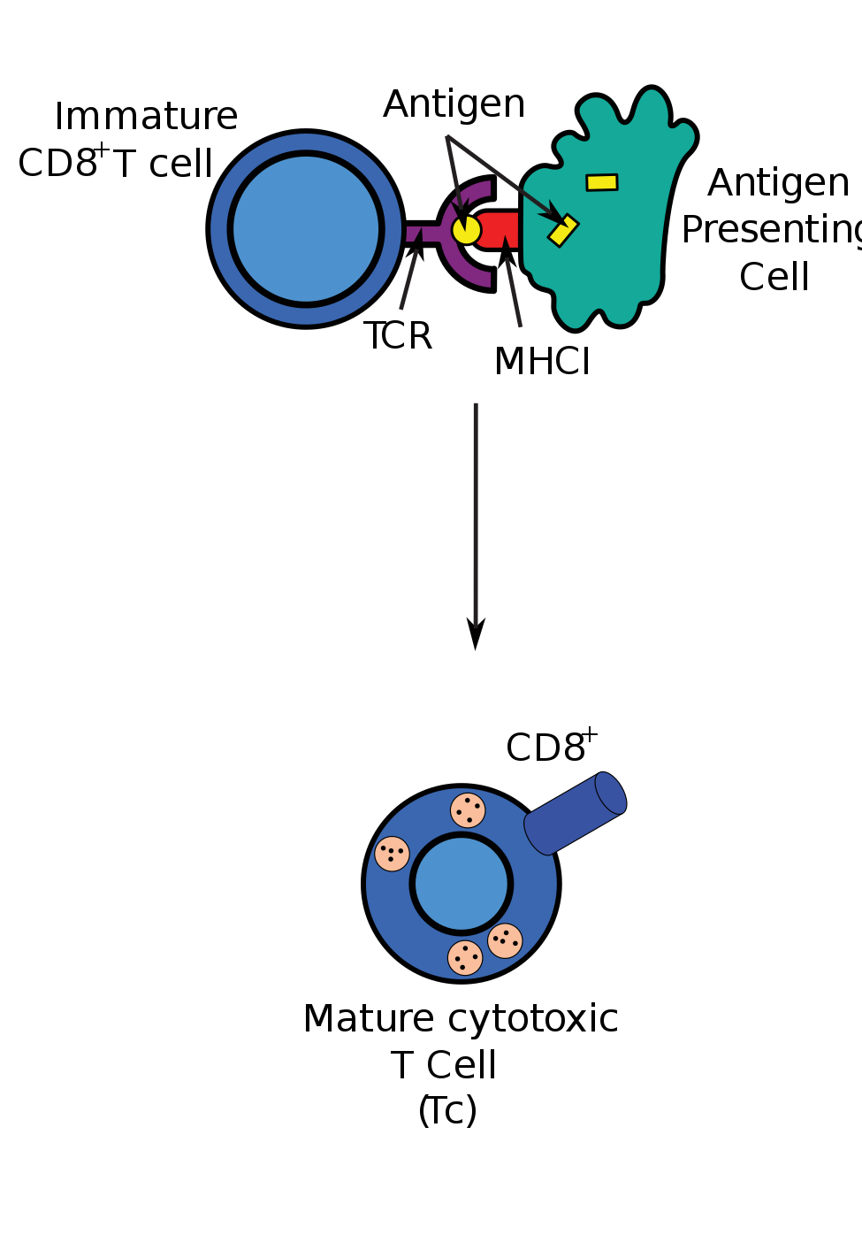
Agent - CD8+ T Cell
Overview:
A CD8+ Naïve T Cell can be activated by an APC, such as a Dendritic cell, a Macrophage, and so on. When active it differentiate into a Cytotoxic T Cell.
When a CD8+ Naïve T cell recognises its antigen and becomes activated, it has three major mechanisms to kill infected or malignant cells:
Secretion of Cytokines: The first is secretion of cytokines, primarily TNF-α and IFN-γ, where the latter activates macrophages
Secretion of Cytotoxic Granules: The second major function is the production and release of cytotoxic granules. Through this granules they trigger the caspase cascade, resulting in apoptosis of the target cell
Figure 10. Activation of a CD8+ Naïve T Cell. [4]

Slide 22
Agent - CD8+ T Cell
Overview:
Destruction via Fas/FasL interactions: The third major function of CD8+ T cell destruction of infected cells is via Fas/FasL interactions. Activated CD8+ T cells express FasL on the cell surface, which binds to its receptor, Fas, on the surface of the target cell. This binding causes the activation of a series of interactions that trigger the caspase cascade, which also results in apoptosis of the target cell
Figure 10. Activation of a CD8+ Naïve T Cell. [4]

Slide 23
Agent - CD8+ T Cell
Implementation:
Like all other immune cells, this cell wander within the grid until either it is activated by an APC cell or until it bumps into an RCC cell.
Upon activation it moves towards the nearest RCC cell that it is able to detect (not self).
When it reaches the RCC cell it has a certain probability (starting from 80%) to destroy the malignant cell.
In this way we implemented the second mechanism of destruction.

Slide 24
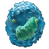
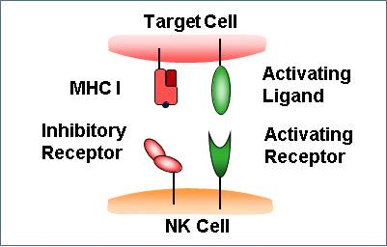
Agent - Natural Killer Cell
Overview:
NK are cells of the innate immune system and best known for protecting against disease and killing virally infected cells, and detecting and controlling early signs of cancer.
NK cells kill tumour cells without any priming or prior activation.
Normal healthy cells express MHC I receptors which mark these cells as self, cancer cells often lose their MHC I, leaving them vulnerable to NK cell killing.
Additionally they secrete cytokines which act on other immune cells like Macrophage and Dendritic cells to enhance the immune response.
Figure 11. Activation of a NK Cell. [7]

Slide 25
Agent - Natural Killer Cell
Implementation:
Movement: if this innate immune cell is not active, it moves randomly by default in search of a tumor cell.
Kill: when a natural killer cell encounters a tumor it becomes active and tries to kill it with a certain probability (killProb), regardless of the presence of the MHC molecule.
Cell stimulation: they also activate macrophages and dendritic cells in their neighbors by setting the active variable to true, simulating the release of IFN-γ and TNF-α.

Slide 26
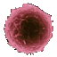
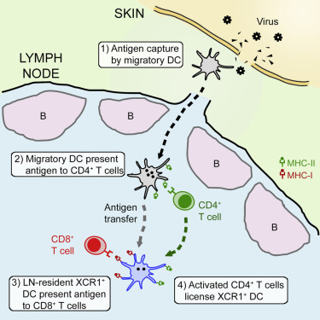
Agent - Dendritic Cell
Overview:
Responsible for the initiation of adaptive immune responses, they are the most potent type of antigen-presenting cells.
During pathogen invasion, immature DCs detect intruders via pattern recognition receptor, capture antigens and quickly leave the tissue. They crawl through and migrate to the draining lymph nodes (LN).
During their migration from the peripheral tissues, DCs undergo phenotypical and functional maturation.
After reaching the LN, DCs move to T-cell zones, present the antigen to TCells and activate them. For instance only one mature DC is required to stimulate 100–3000 TCells.
Figure 12. Behaviour of an activated dendritic cell. [8]

Slide 27
Agent - Dendritic Cell
Implementation:
Not mature: randomly moves in search of a tumor cell
Mature: when a tumor is discovered it moves in the direction of the lymph node (outside the grid, simulating the antigen presentation). On the way, if it encounters a TCell it is also able to activate its effect. When it is on the edge of the grid, a number of CD8 and CD4 are introduced into the grid (depending on their ratio). Then it become not mature

Slide 28

Agent - Plasmacytoid Dendritic Cell
Overview:
It is a rare type of dendritic immune cell that are known to secrete large quantities of type 1 interferon (IFNs) in response to a viral infection.
For example, the secretion of type 1 interferon α triggers Natural Killer cells to produce IFNγ.
In addition, they can produce cytokines as well, helping to recruit other immune cells to the site of infection and serve as a bridge between innate and adaptive immunity.
Implementation:
Same behavior as Dendritic cells but, once they have reached the LN, they also introduce into the grid some Natural Killer cells.

Slide 29
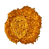
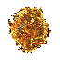
Agent - Macrophage
Overview:
Macrophages are specialised cells involved in the detection, phagocytosis and destruction of bacteria and other harmful organisms.
The way they interact with the immune system depends on their polarization:
M1-polarized macrophages promote inflammation and immune response (they are activated by the release of IFN-γ and once active release IFN-γ and TNF-α)
M2-polarized macrophages suppress inflammation and immune response (they are activated by the release of IL-10 and TGF-β and once active release IL-10, TGF-β, and TNF-α).

Slide 30
Agent - M1 and M2
M1 Implementation:
Immune response activation: stimulate the activation of NK cell, Dendritic cell and other M1 by setting their active variable to true (simulating the release of IFN-γ and TNF-α)
M2 Implementation:
Immune response suppression: inhibit the activation of TCell, Dendritic and M1 by setting active to false and stimulate other M2 (simulating the release of IL-10 and TGF-β)
Phagocytosis: both of them randomly move looking for Dead Cell to ingest

Slide 31
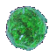
Agent - Mast Cell
Overview:
Mast Cells are best known for their activity in allergic reactions, but they have been involved in different conditions, like in renal cell carcinoma where they can promote angiogenesis.
It is a migrant cell of connective tissue that contains many granules.
During degranulation, they release a large variety of mediators that could act in an unpredictable manner depending on the context:
ProTumor effect promoting tumor growth and progression
AntiTumor effect promoting TCell, APC and other cells activation

Slide 32
Agent - Mast Cell
Implementation:
Movement: randomly move in search of cancer cells
Effect: when it is close to a tumor cell, it can have either a pro-tumor or anti-tumor effect (50%). If it is ProTumor it promotes tumor growth, otherwise it can activate the effect of nearby Tcells (set active variable to true), to simulate the release of mediators in its granules

Slide 33

Agent - Blood Cell
Overview:
Agent used to represent the blood and in particular the tumor angiogenesis effect.
Implementation:
This Class it is used to represent a single blood vessel (the other ones are supposed to be outside the grid) and it can be placed on top / bottom / left / right of the grid (as input parameter).
When a Blood cell has a certain number of tumor cells (or more) in its neighbors, it can be the target of tumour angiogenesis, in which case tumour growth is increased and a new Blood cell is created.

Slide 34
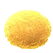
Agent - Adipocyte
Overview:
Adipocytes, also known as lipocytes or fat cells, are the cells that primarily compose adipose tissue, specialized in storing energy as fat.
In obese patients these cells are present in greater quantities.
Implementation:
Adipocyte class is a dummy agent, just a placeholder for cells (fat) that composes the kidney itself and they do not perform any action.

Slide 35

Agent - Dead Cell
Overview:
Agent used to represent a Dead cell.
Implementation:
A Dead cell is a dummy agent and can not perform any action.
A cell reaches the dead state if it has been killed by an immune cell or it has exceeded its maximum age in order to simulate apoptosis effect.

Slide 36
Agent - Empty Cell
Overview:
Agent used to represent a Empty cell.
Implementation:
Empty cell is a dummy agent simply implemented to simulate empty spaces and to allow cells to move around.

Slide 37
Environment in Repast
The environment wasn’t implemented as a Java Class but was represented only as 3 parameters that the user can choose:
BMI - integer between 15 and 40. The number and percentage of initial Cells depend on this values
Blood Vessel - represented as a set of Blood cells positioned in one of the possible orientations of the grid (north / south / west / east or front / back / up / down / left / right)
Lymph Node - represented as a direction towards which some cells will move when active (north / south / west / east or front / back / up / down / left / right)

Slide 38
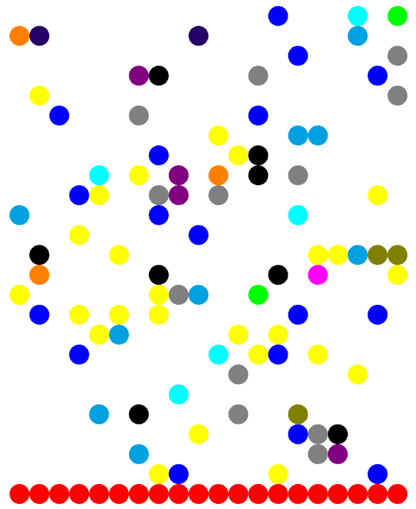
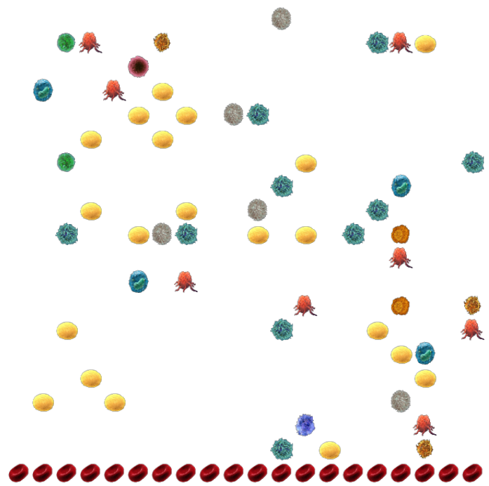
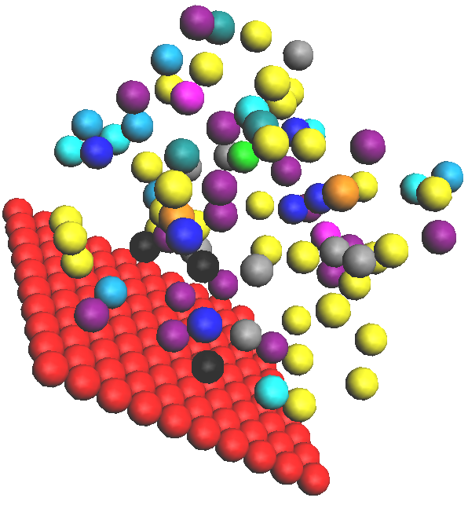
Environment - Grid 2D vs 3D
Grids are a mainstay of agent based simulation and they can be used to simulate spaces and to create highly structured relationships between agents.
Grids are a 1 or more dimensional data structure (n-dimensional matrix) that is divided up into a number of cells. These cells can be referenced by their integer coordinates.
In our project we implemented both a 2-dimensional and a 3-dimensional grid in which the agents can move and interact with each other.
2D Grid. 2d representation of agents with simple circles
2D Grid. 2d representation of agents with images
3D Grid. 3d representation of agents with spheres

Slide 39
Agents - Main features
Only one agent in each cell
Random positioning
An agent cannot go outside the grid
Number of immune cells can’t be more than 10% of the grid’s size at tick 0
Number of each immune cell depends on BMI or on cd4/cd8 ratio
Renal cell carcinomas occupy 2% of the grid’s size
NK and CD8 kill probability are internally set and don’t change

Slide 40
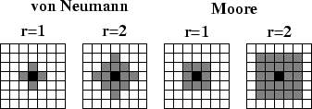
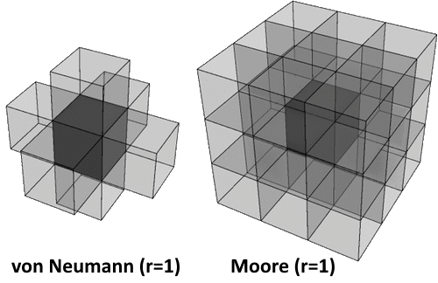
Agents’ Behaviour and Effects
@ScheduledMethod annotation to manage the priority of each action
Interaction between agents and effects range have been implemented in one of these three ways:
neighborhood - an agent or an effect may influence only the nearby cells (Moore)
radius - an agent or an effect may influence only the cells within a certain radius
grid - an agent or an effect may depend on or influence the whole grid (e.g. spawn new cells, move towards the nearest tumor, etc…)
Most actions and effects happen with a certain probability

Slide 41
Repast settings
Styles and Displays: different styling and displaying options for agent visualization:
2D display with cells represented as circles - XML stylesheets
2D display with an image for each cell type - a style Class for each cell
3D display with cells represented as sphere - a single Class to manage all the colors
Scenario: ObesityParadox.rs and ObesityParadox3D.rs folders with all the configuration files needed for the context, displays, dataset loaders, parameters initialization and so on

Slide 42
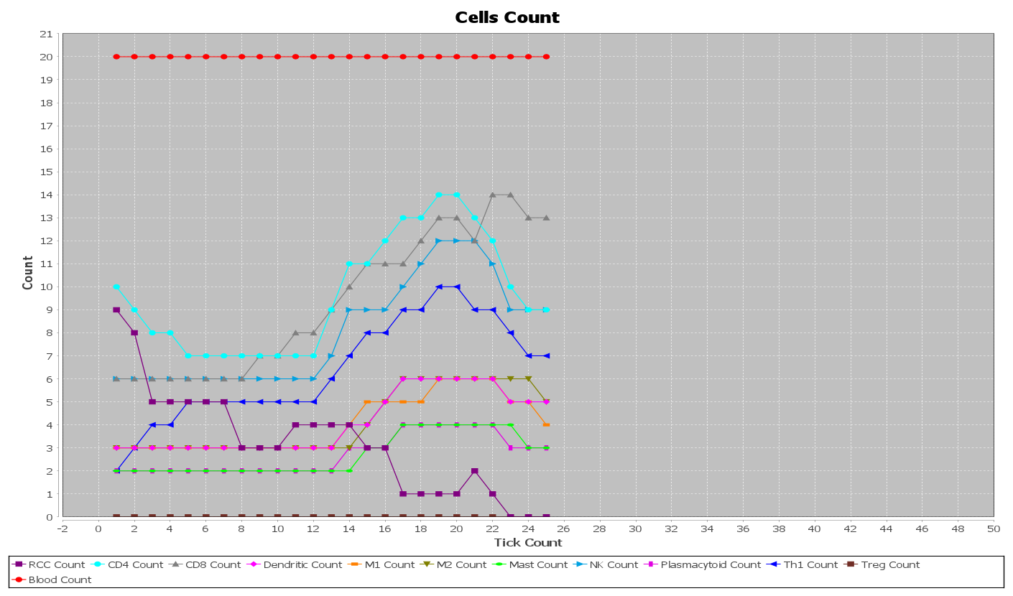
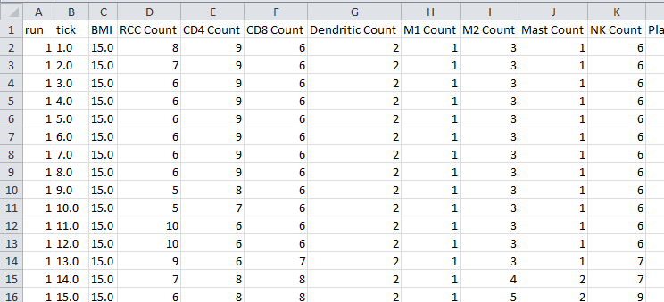
Model and visualization
Chart: other than visualization styles and displays, Repast Simphony allows for the creation of Time Series Chart and more. In this case we created only one chart containing all the cells in the grid at each tick, to better see how the environment evolves, but the possibilities are endless
Data Set: is the model data in memory, whose content is, however, not in a human-readable format and gets deleted when Repast is closed. To avoid that, we can send the Data Set content to a Text Sink
Text Sink: is used to send data to either the Eclipse program console or to an output file; since we wanted to have the model available for later analysis, we dumped the model via a File Sink, that is used to write data to a file
Time Series Chart. A chart showing the evolution of the system
File Sink. The model output as a CSV file

Slide 43
Launchers and Batch parameters
Parameters: XML file used to configure other parameters:
Width, Height (and Depth) of the grid
Tumor mutation percentage, reproduction time and factor, percentage of disabling TCells
Immune cell growth percentage
Batch Parameters: also configured through an XML file. They have the same names of the parameters, but the values may be different or even range from a starting value to an ending value with a user defined step increment. The numbers of runs can also be defined here
Launchers: the Eclipse launch configuration files that are used to run the Repast model. To simplify the development and the testing phases, we created a launcher for each configuration, both 2D and 3D

Slide 44
Batch runs
Allow to run the model several times (in order to minimize the impact of potential outliers) with a different set of parameters each time.
100 runs
Duration of 100 ticks
BMI increasing each run by 1 from 15 to 40
A total of 2600 runs
Data was taken as snapshots at 10, 50, 100 ticks

Slide 45
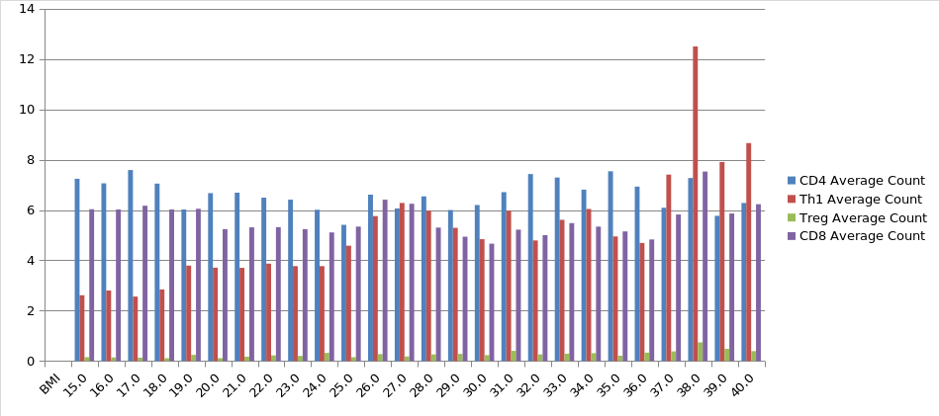
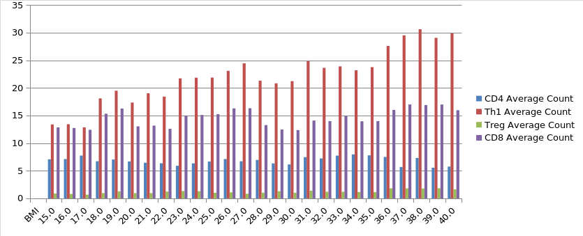
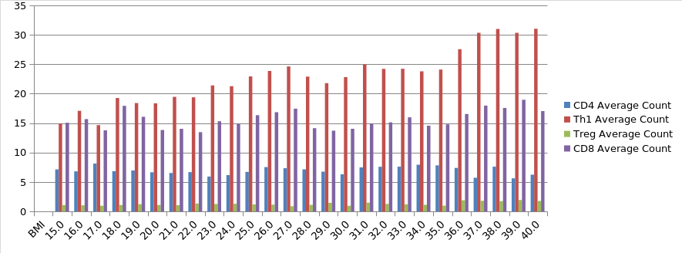
Result

Slide 46
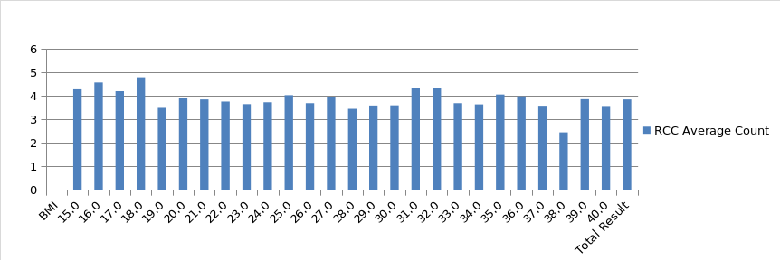
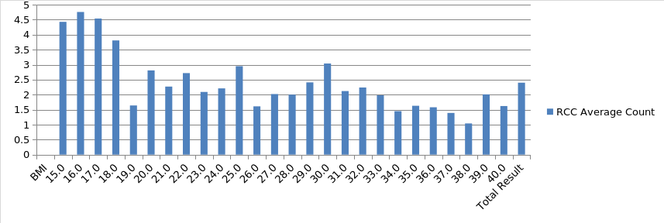
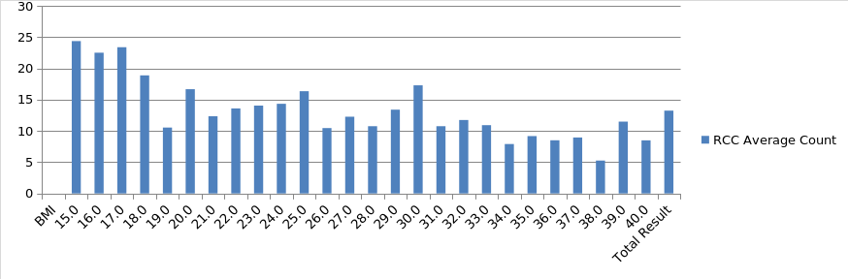
Result 2

Slide 47
Future works
Even though the system behaves as we expected, there are still some improvements that can be done:
Add further cells and behaviours, such as: B Cells, Memory T Cell, Th2, opsonizing mechanism, etc…
Add cells speed and improve activation mechanism
Adjust cells percentage in the 3D context

Slide 48
Reference List
Santoni M., et al. (2020). Unlocking the secret of the obesity paradox in renal tumours. The Lancet Oncology, 21(2), 194-196. doi:10.1016/s1470-2045(19)30783-1
Loizzi, V., et al. (2017). Biological Pathways Involved in Tumor Angiogenesis and Bevacizumab Based Anti-Angiogenic Therapy with Special References to Ovarian Cancer. International Journal of Molecular Sciences, 18(9), 1967. doi:10.3390/ijms18091967
Santoni, M., et al. (2019). Circulating Tumor Cells in Renal Cell Carcinoma: Recent Findings and Future Challenges. Frontiers in Oncology, 9. doi:10.3389/fonc.2019.00228
Adapted from File:Antigen presentation.svg. (2020, December 16). Wikimedia Commons, the free media repository. Retrieved 16:12, January 16, 2021 from https://commons.wikimedia.org/w/index.php?title=File:Antigen_presentation.svg&oldid=519246997.
Moncrieffe, H. (n.d.). Regulatory T Cells (Tregs). Retrieved from https://www.immunology.org/public-information/bitesized-immunology/cells/regulatory-t-cells-tregs
Romagnani, S. (1999). Th1/Th2 Cells. Inflammatory Bowel Diseases, 5(4), 285-294. doi:10.1097/00054725-199911000-00009
Eissmann, P. (n.d.). Natural Killer Cells. Retrieved from https://www.immunology.org/public-information/bitesized-immunology/cells/natural-killer-cells
Hor, J., Whitney, P., Zaid, A., Brooks, A., Heath, W., & Mueller, S. (2015). Spatiotemporally Distinct Interactions with Dendritic Cell Subsets Facilitates CD4 and CD8 T Cell Activation to Localized Viral Infection. Immunity, 43(3), 615. doi:10.1016/j.immuni.2015.08.018
Adapted from File:Diagram of a lymph node CRUK 022.svg. (2020, October 27). Wikimedia Commons, the free media repository. Retrieved 22:07, January 16, 2021 from https://commons.wikimedia.org/w/index.php?title=File:Diagram_of_a_lymph_node_CRUK_022.svg&oldid=503059642.

Slide 49
That’s all folks!

